Slide 1
MKTG 2505: Marketing Analytics
Online Retail Market Analysis

Slide 2
Table of Contents
Data Description
Data Cleaning/EDA
Situation Analysis
Market Basket Analysis
Customer Cluster Analysis
Recommendations

Slide 3
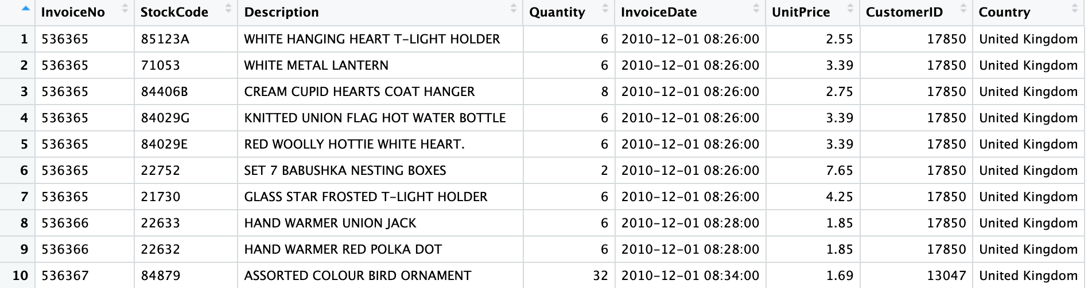
Data Description
Data contains transactional data from an online retailer specializing in selling gift items, home decor, and other products.
Products range from hanging t-light holders to cake tins, glass trinket pots, and more.
Transactions range from one to up to 80,995 items.
Can use CustomerID and InvoiceNo columns to identify customers, what they order, the size of their orders, and how often they order
Raw data includes 541,909 rows and 8 columns.

Slide 4
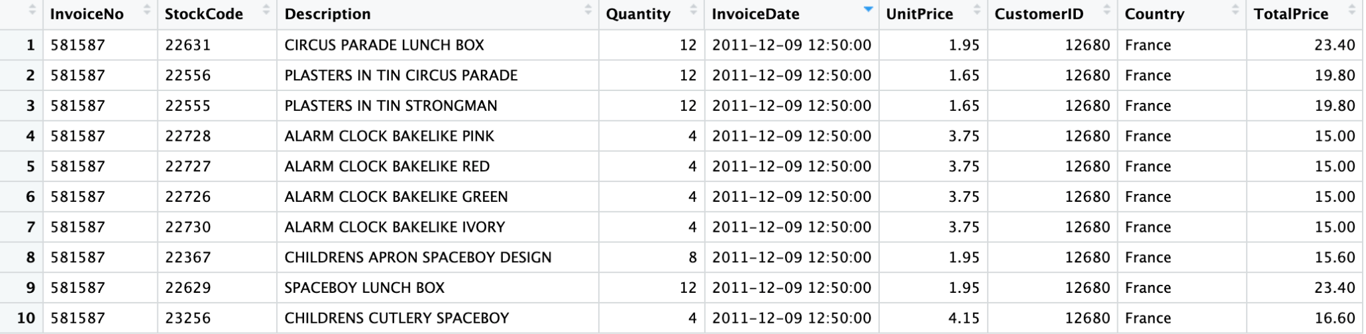
Data Cleaning (EDA)
Remove rows with negative values in Quantity and UnitPrice.
Remove missing values, negative quantities and prices, and transactions with no customer ID.
Drop all duplicates.
Remove rows with extreme values in Quantity or UnitPrice (outliers).
Standardize formatting of text in the description column.
Add a TotalPrice column (UnitPrice x Quantity)
Apply log transformation to the Quantity and UnitPrice columns.
New dataframe includes 392,692 rows and 9 columns.
→ There are 4290 unique customers are involved in online retail purchases.
→ The return rate for all the products is 1.96 %. However, lots of products had 100 % return rate

Slide 5
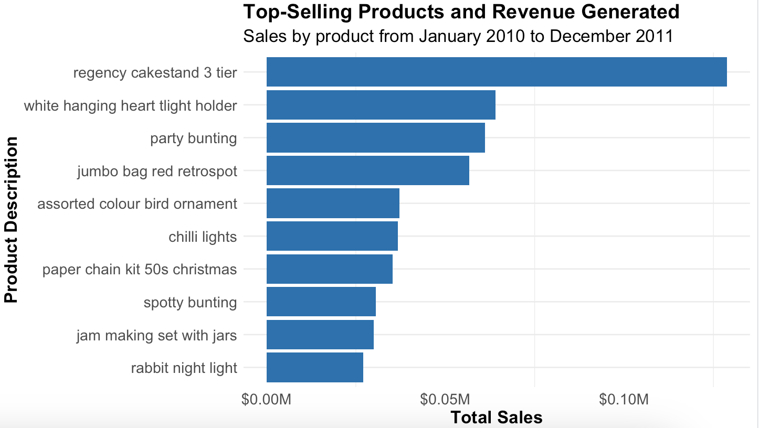
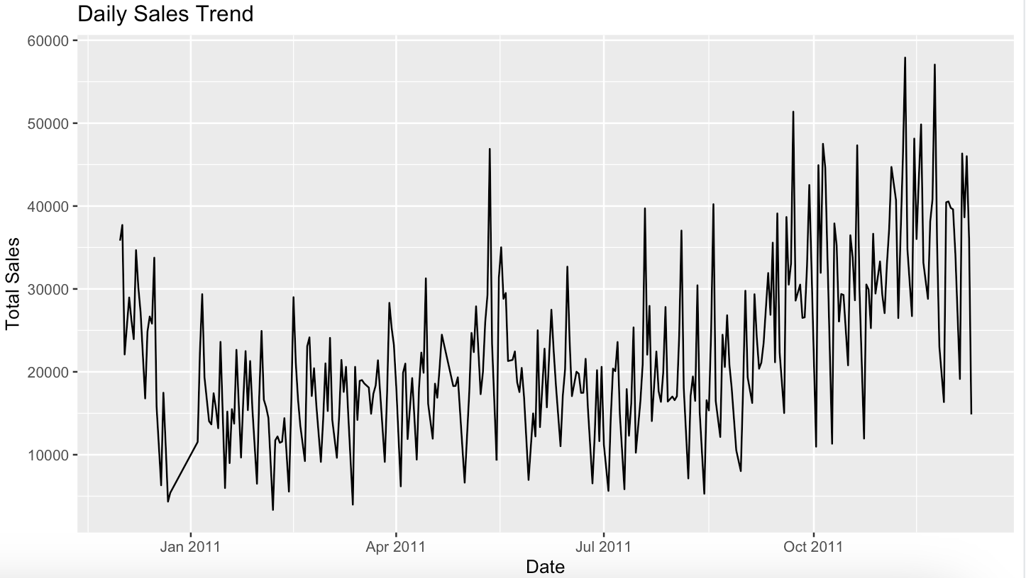
Situation Analysis
We first plotted daily sailes (right). These are consistent except for a few outliers every couple months.
On the left, you see the top selling products in dollars.
Sales grew steadily over time until the end of the dataset in December 2011.

Slide 6
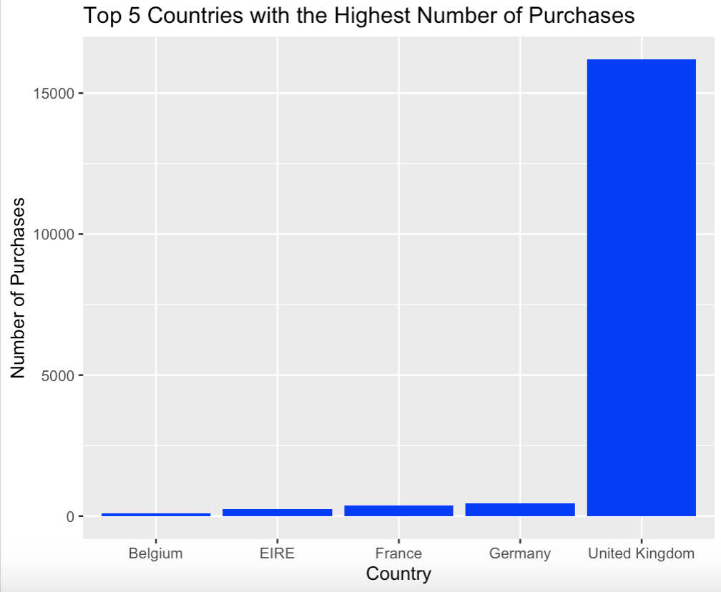
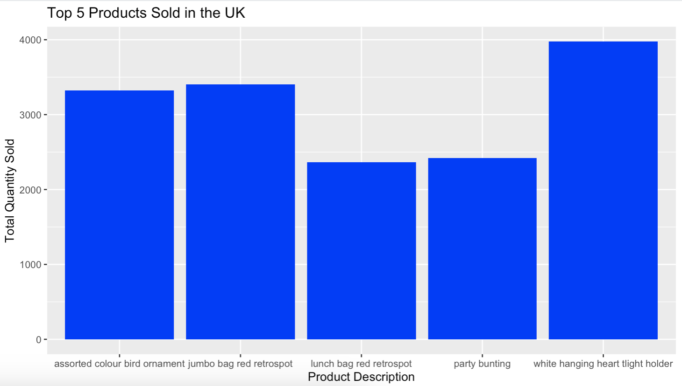
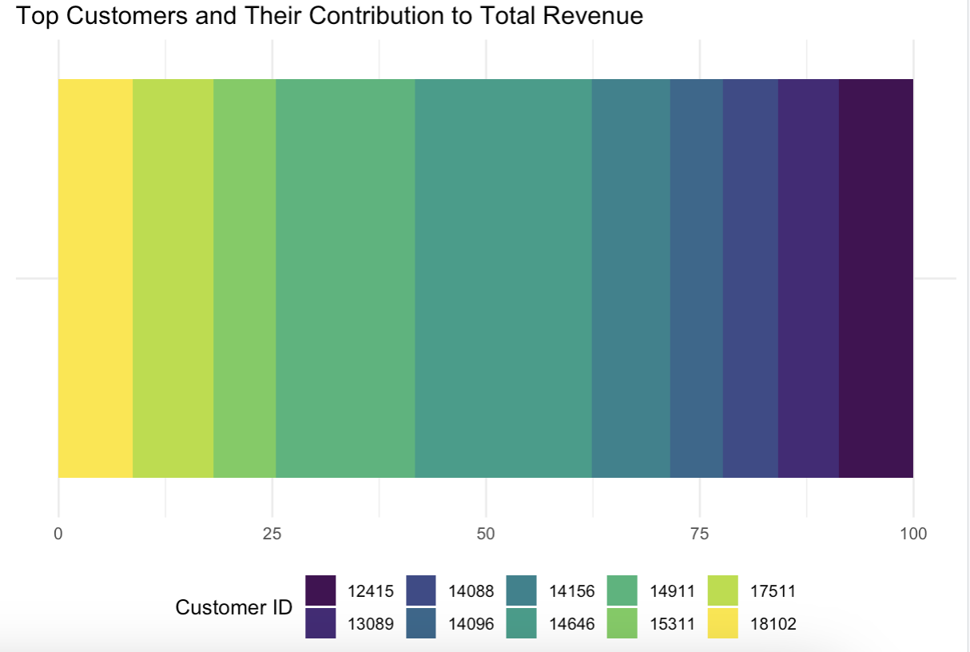
Situation Analysis II
→ Top customers and their contribution. 10 unique customers made up the vast majority of total sales.
→ Most purchases made in UK
→ The top Product in UK is “white hanging heart light holder”

Slide 7
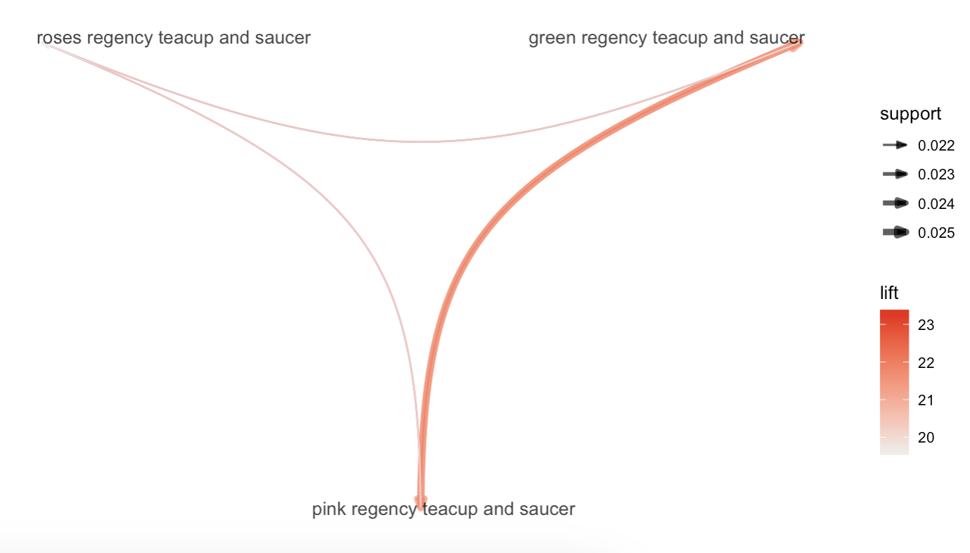
Market Basket Analysis
Customers who purchase both the "GREEN REGENCY TEACUP AND SAUCER" and the "ROSES REGENCY TEACUP AND SAUCER" are likely to also purchase the "PINK REGENCY TEACUP AND SAUCER"
Improve sales by placing these 3 items close to each other
Offering bundle deals or discounts on the combination of the three items
Promoting purchase of "PINK REGENCY TEACUP AND SAUCER" to customers who already bought the "GREEN REGENCY TEACUP AND SAUCER" and the "ROSES REGENCY TEACUP AND SAUCER"
Notes:
Market Basket Analysis: For products likely to be purchased together.
The rule suggested that customers who purchase both the "GREEN REGENCY TEACUP AND SAUCER" and the "ROSES REGENCY TEACUP AND SAUCER" are likely to also purchase the "PINK REGENCY TEACUP AND SAUCER" with a high confidence of 0.720 and a lift of 23.363. The support of this rule is 0.022, meaning that this combination of purchases occurs in only 2.2% of all transactions. The lift of 23.363 suggests that this combination of purchases is much more likely to occur together than expected if the purchases were independent. Overall, this rule can be used to improve sales by placing these three items close to each other, offering bundle deals or discounts on the combination of these three items, or promoting the purchase of "PINK REGENCY TEACUP AND SAUCER" to customers who have already bought "GREEN REGENCY TEACUP AND SAUCER" and "ROSES REGENCY TEACUP AND SAUCER.”

Slide 8
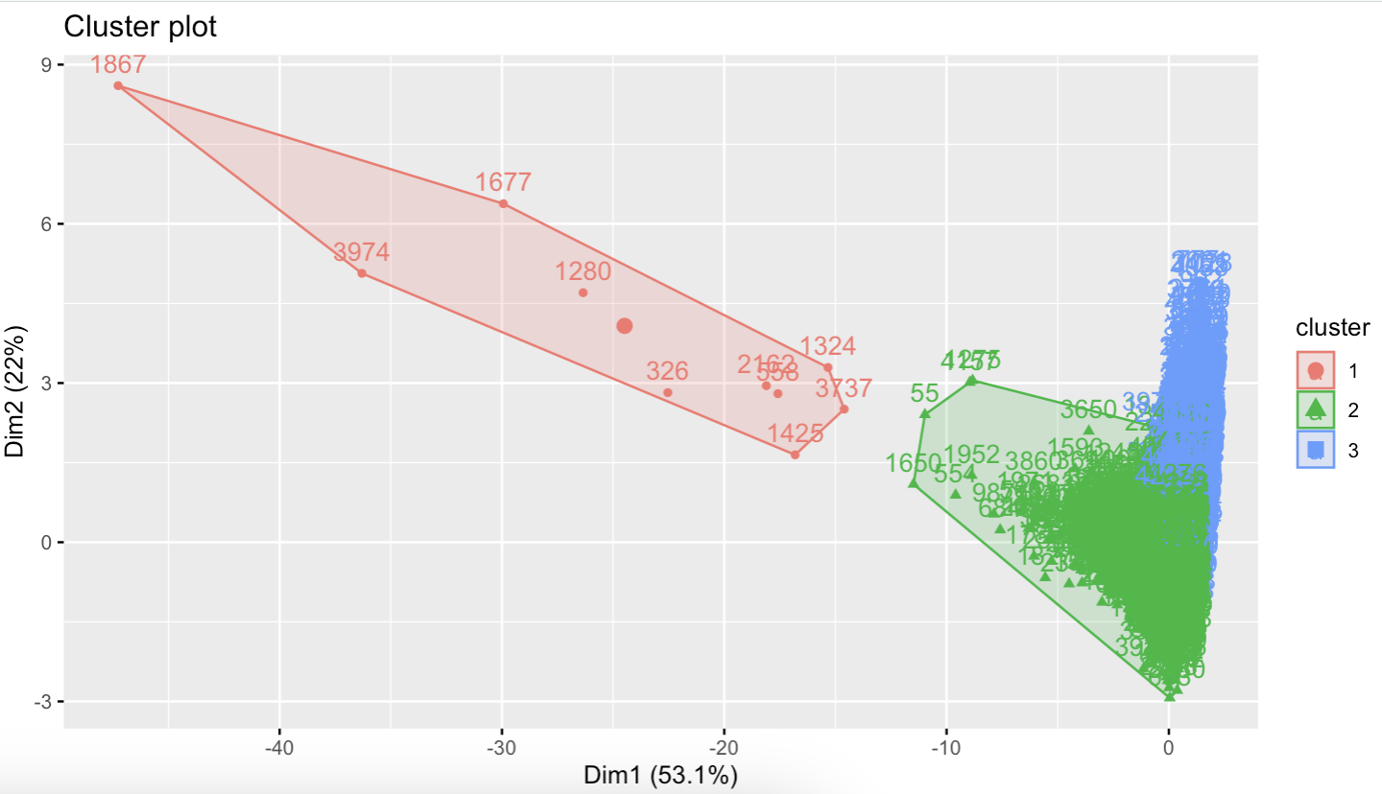
Customer Cluster Analysis
Use kmeans to segment customers
Three clusters had the most insights
Three customer segments:
Wholesalers
Loyal Customers
Opportunistic Customers

Slide 9
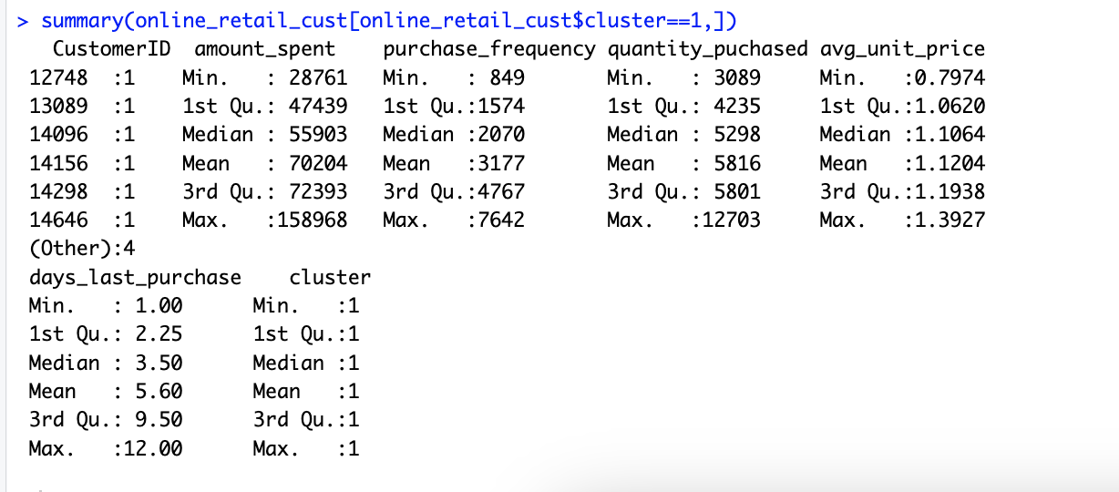
Wholesalers
Smallest group
Second highest contribution to revenue
Important to maintain a relationship with them

Slide 10
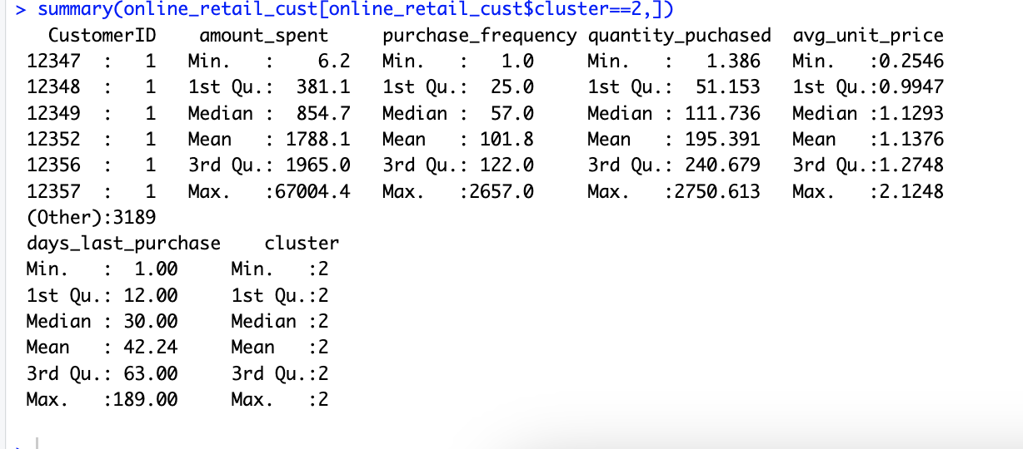
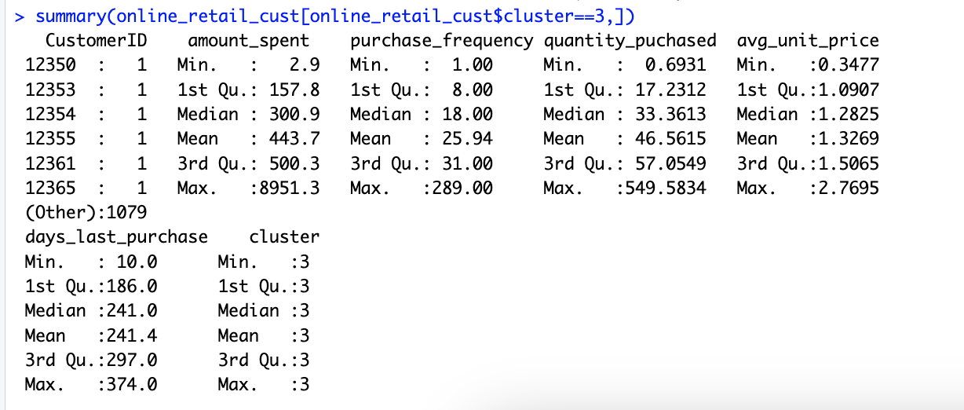
Loyal vs Opportunistic Customers
Loyal Customers:
Largest customer segment
Four times more purchases and amount spent than opportunistic
Opportunistic Customers:
Lowest in all categories except average unit price per customer
Lowest priority segment with marketing

Slide 11
Recommendations
→ The company should increase inventory to meet the higher demand, since sales are the highest during holiday season.
→ Since the "regency cakestand 3 tier" is a popular product, the company can promote related products, such as other cake stands or baking accessories.
→ From the “top consumers” insights, the company should provide personalized services to them, including offering exclusive discounts, early access to new products, and dedicated customer support
→ Since the UK is the country with the highest purchases, the company should focus on this market to increase sales, and for the top products that are purchased in the UK, the company should analyze why the products are the most frequently purchased products. Is it because of their quality, design, or price?

